Slide 1
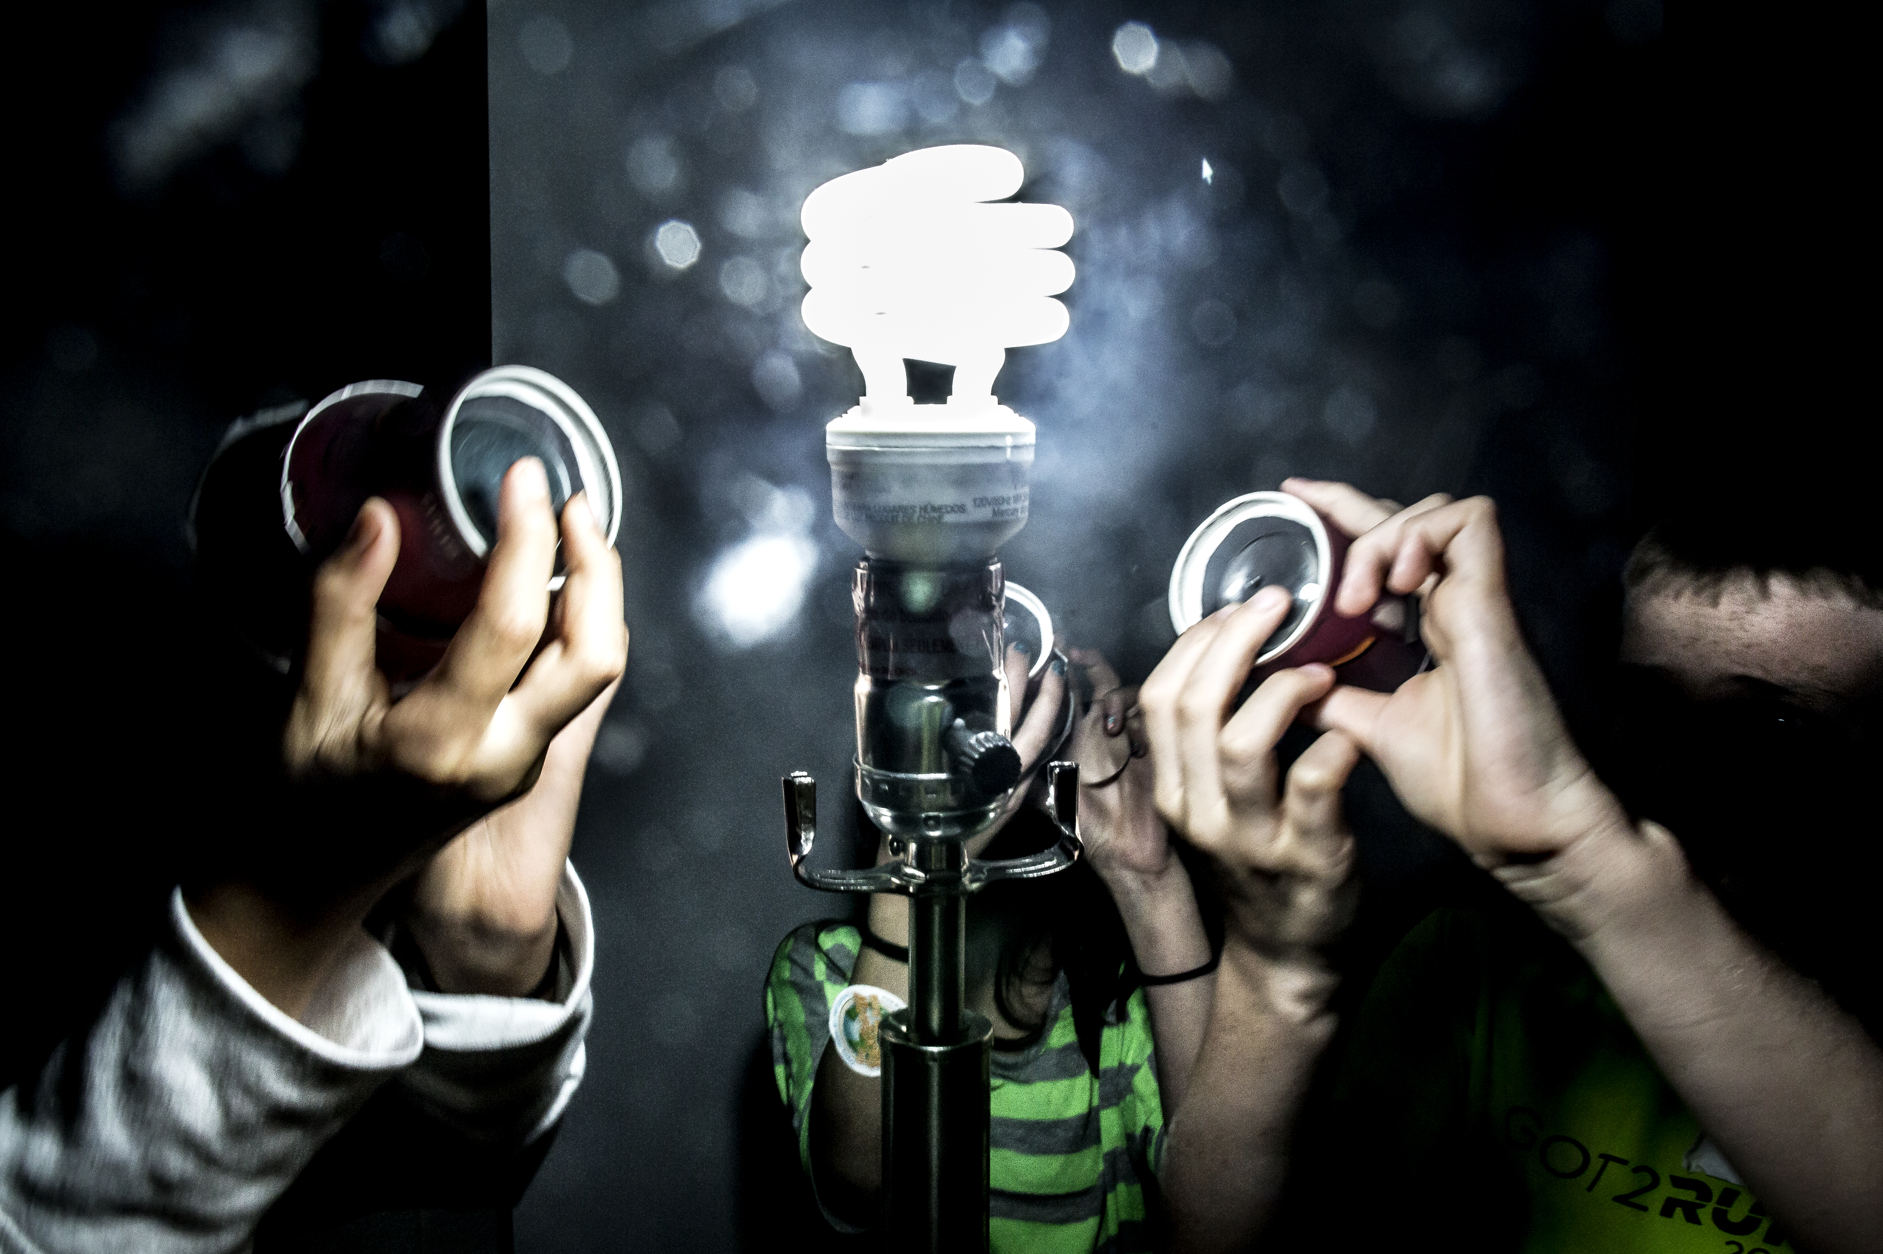
Foundations of Computer Vision Introduction
EECS 442 Fall 2017
https://umich.instructure.com/courses/173857
Instructor: Jason Corso
jjcorso@umich.edu
Materials on these slides have come from many sources in addition to myself; I am infinitely grateful to these, especially Greg Hager and Silvio Savarese.

Slide 2

Source: http://www.ted.com/talks/sebastian_thrun_google_s_driverless_car?

Slide 3
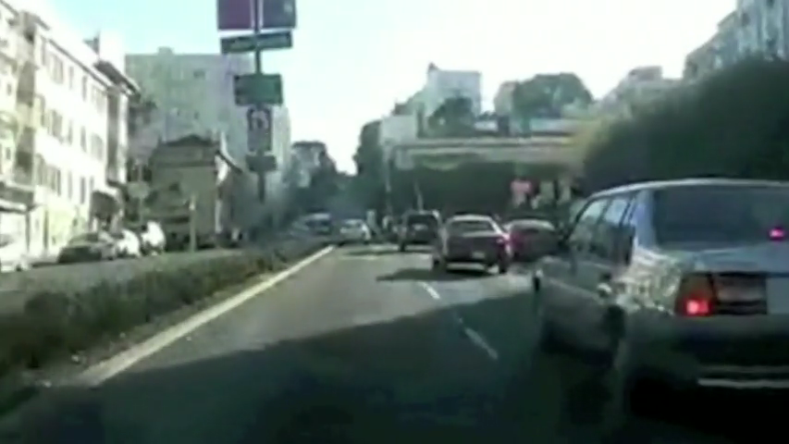
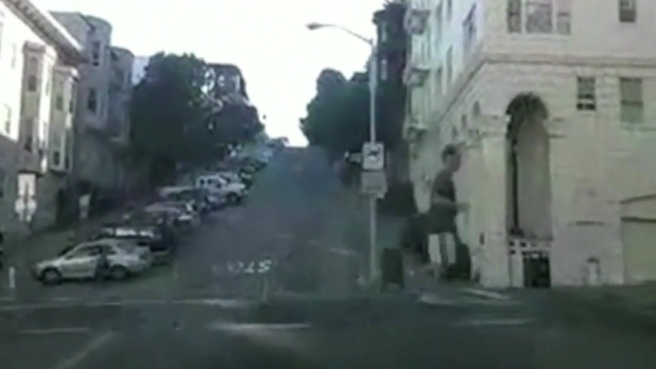
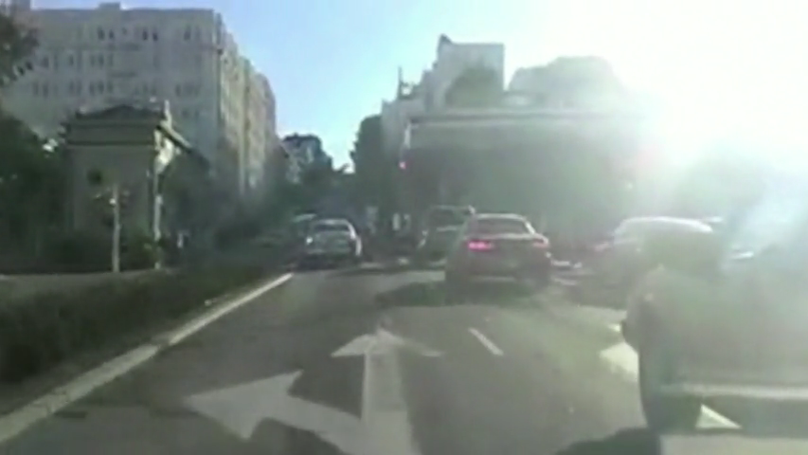
Your turn!
Form groups of 4.
You are a new “Computer Vision Startup Design Team”!
Select one of the three tasks.
Solve the task using the knowledge you currently have about computer vision, if any.
What are the challenges? What is easy?
Discuss for 5 minutes.
Lane Following
Pedestrian Avoidance
Intersection Detection
Notes:
----- Meeting Notes (9/9/15 12:30) -----
have examples of why simple ideas do not work

Slide 4
What is Computer Vision?
What is Computer Vision?
Notes:
The basic belief of Aristotle is that the sensory organ transformed once it to match the object of perception in a dynamic process. To see is to know.
388-322 BC

Slide 5
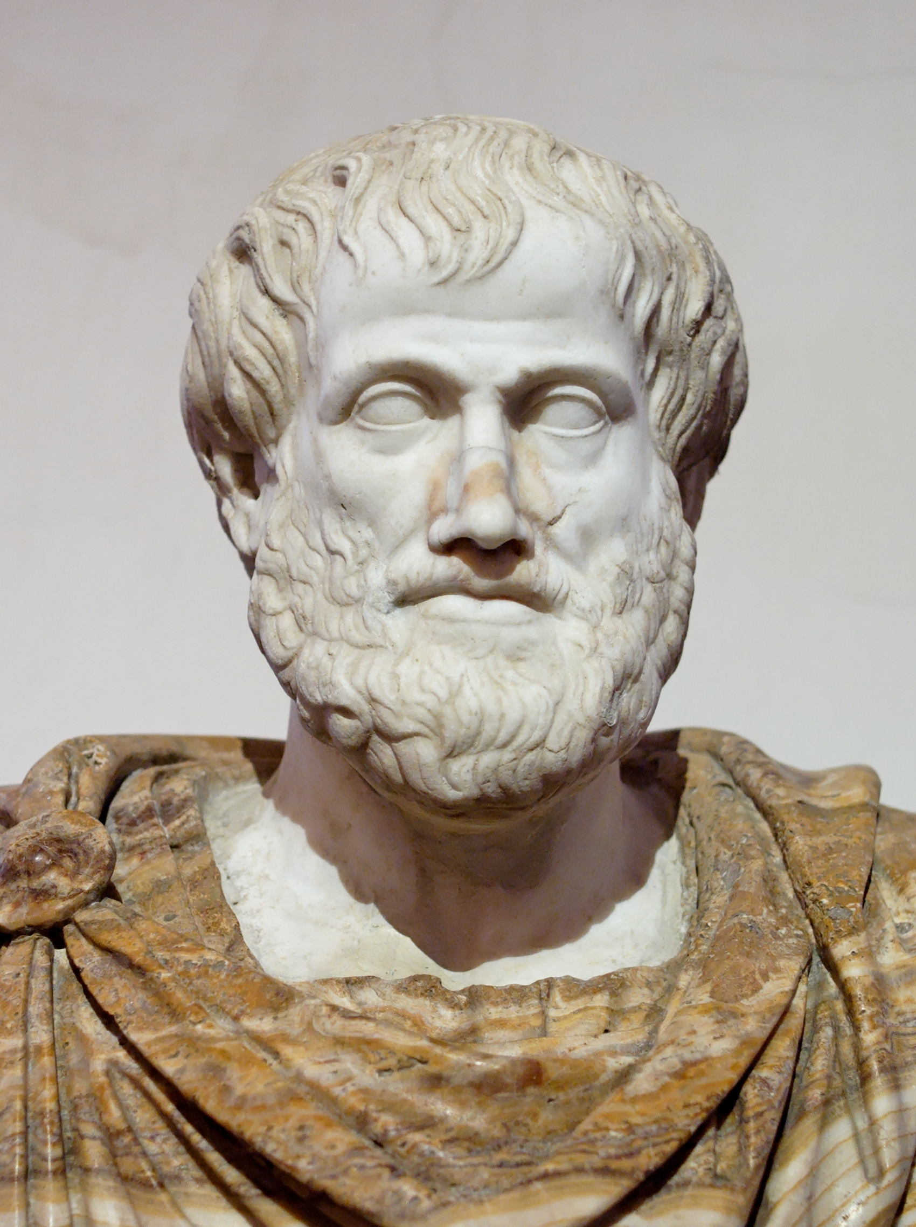
What is Computer Vision?
Aristotle, De Anima (On the soul)
"...when once [the sensor, the eye] has been acted upon, it is similar and has the same character as the sensible object.”
Contrast with modern definition:
“to know what is where by looking.”
“vision is the process of discovering from images what is present in the world, and where it is.”
Both quotes from Marr 1982.
Notes:
The basic belief of Aristotle is that the sensory organ transformed once it to match the object of perception in a dynamic process. To see is to know.
388-322 BC

Slide 6
What is Computer Vision?
Ballard and Brown (1982)
The construction of explicit, meaningful descriptions of physical objects from images.
Trucco and Verri (1998)
computing properties of the 3D world from one or more digital images.
Stockman and Shapiro (2001)
To make useful decisions about real physical objects and scenes based on sensed images.
Forsyth and Ponce (2003)
...extracting descriptions of the world from pictures or sequences of pictures.
Extraction of information from visual content.

Slide 7
What is Computer Vision?
Vision is the representation and extraction of information from visual content.
Computer Vision is the representation and extraction of information from visual content by a computer system.
Or, vision by a computer (now that we have adequately defined vision)
Computer Vision is hence characterized by the study of
Representations of visual content and world that gave rise to it.
Mathematical formalisms and computational algorithms of the representations, their properties, and the process of information extraction from visual content.
Properties of the visual content, the production of visual content, and the mathematics and algorithms for processing it. Most important of these is invariance.

Slide 8
Some related terms
Image Processing: the study of the properties of operators that produce images from other images
we will touch on image filtering and related operators from image processing
Machine Vision: a somewhat outdated term which now tends to refer to industrial vision applications where (usually) a single camera is used to solve a structured inspection task
the “reverse CAD” model
Pattern Recognition: typically refers to the recognition of structures in 2D images (usually without reference to any underlying 3D information).
Photogrammetry: the science of measurement though non-contact sensing, e.g. terrain maps from satellite images. Usually is more focused on accuracy issues than interpretation.
Source: G.D. Hager Slides.

Slide 9
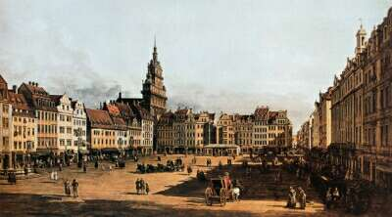
What information is in images?
Source: GD Hager slides.

Slide 10
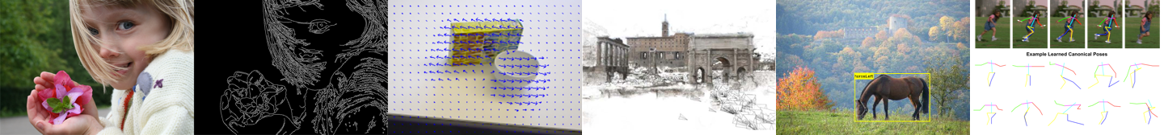
Five classes of information in visual content
Early Processes
extracting basic features, edges, contours, and segmentation.
Motion Tracking
extracting movement, optical flow, tracking, and filtering.
Shape
extracting 2D and 3D structure, epipolar geometry, stereo, SFM, shape from X.
Objects
extracting objects, detection, recognition, and matching.
Actions
extracting actions, space-time localization, detection

Slide 11
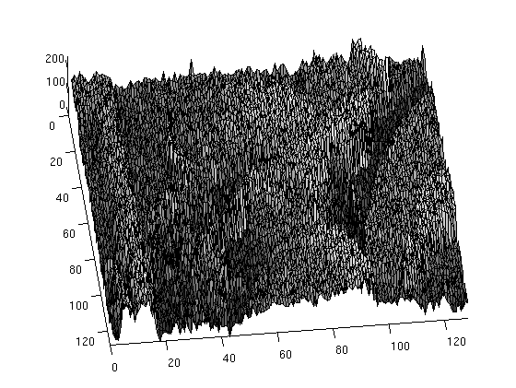
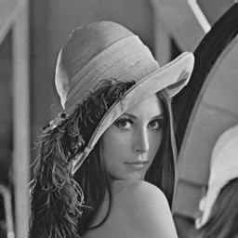
Extracting that information is harder than you think

Slide 12
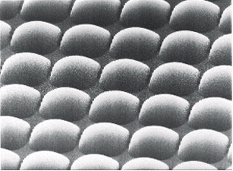
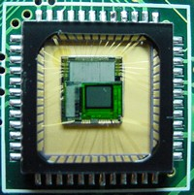
Example of sensors and image formation
Basic image sensing process:
photons hit a detector
the detector becomes charged
the charge is read out as brightness
Sensor types:
CCD (charge-coupled device)
more common
high sensitivity
high power
cannot be individually addressed
blooming
CMOS
simple to fabricate (cheap)
lower sensitivity, lower power
can be individually addressed
Source: G.D. Hager Slides.

Slide 13
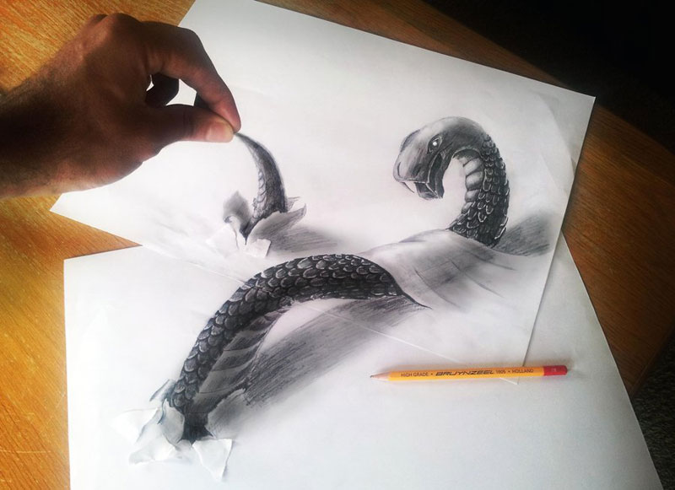
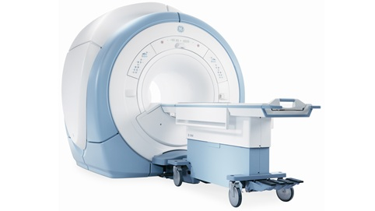
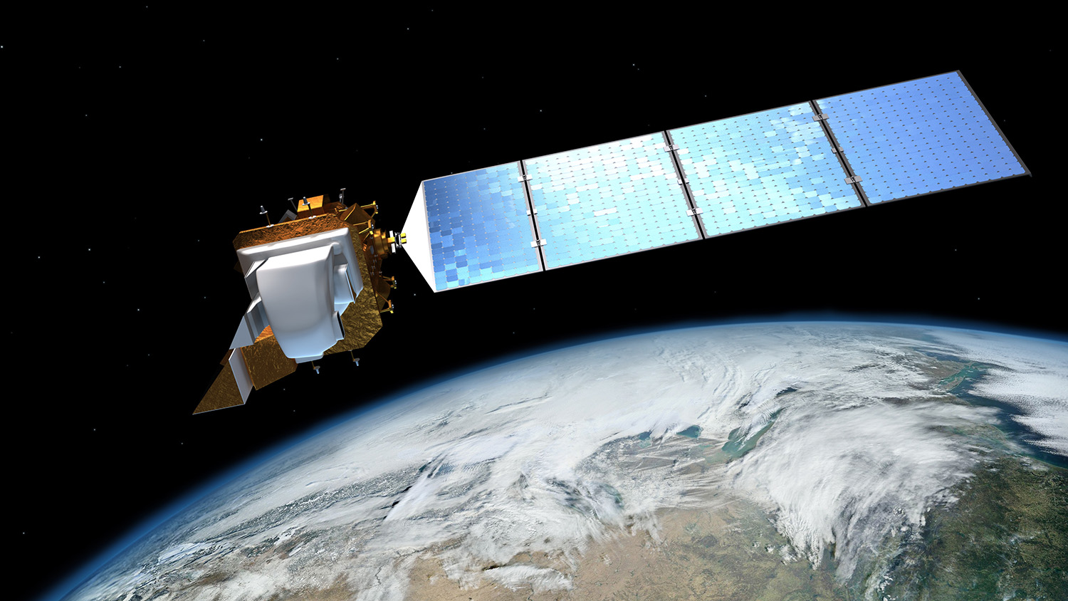
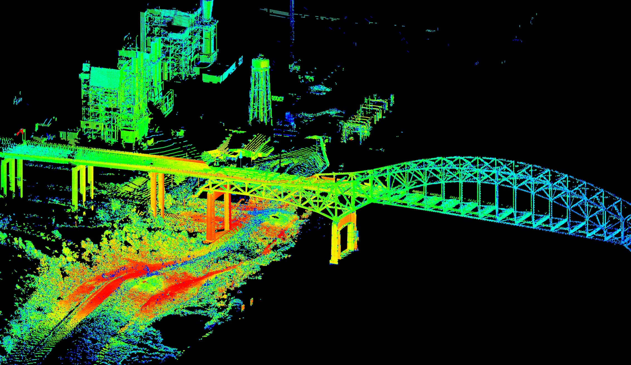
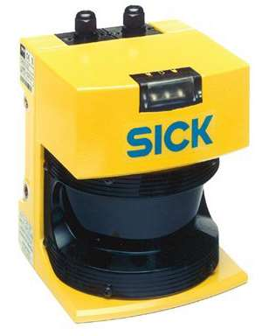
But, visual content can also be produced by
Source: http://webneel.com/3d-drawings-pencil-art.
Source: http://www3.gehealthcare.com/.
Source: https://svs.gsfc.nasa.gov/.
Source: http://gallery.usgs.gov/.
And, computer vision is useful in all of these!
Notes:
http://gallery.usgs.gov/photos/09_01_2012_rVMy5DCp53_09_01_2012_0#.Ve87XGTBzRa
https://svs.gsfc.nasa.gov/cgi-bin/details.cgi?aid=11432

Slide 14
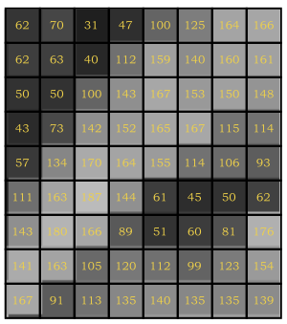
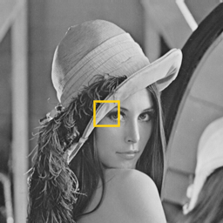

Example of sensors and image formation
Each pixel is a measure of the brightness (intensity of light)
that falls on an area of an sensor (typically a CCD chip)

Slide 15
Example of sensors and image formation
Getting the light to the sensor.
Add a barrier to block most of the light rays: aperture.
Source: GD Hager and S Seitz slides.

Slide 16
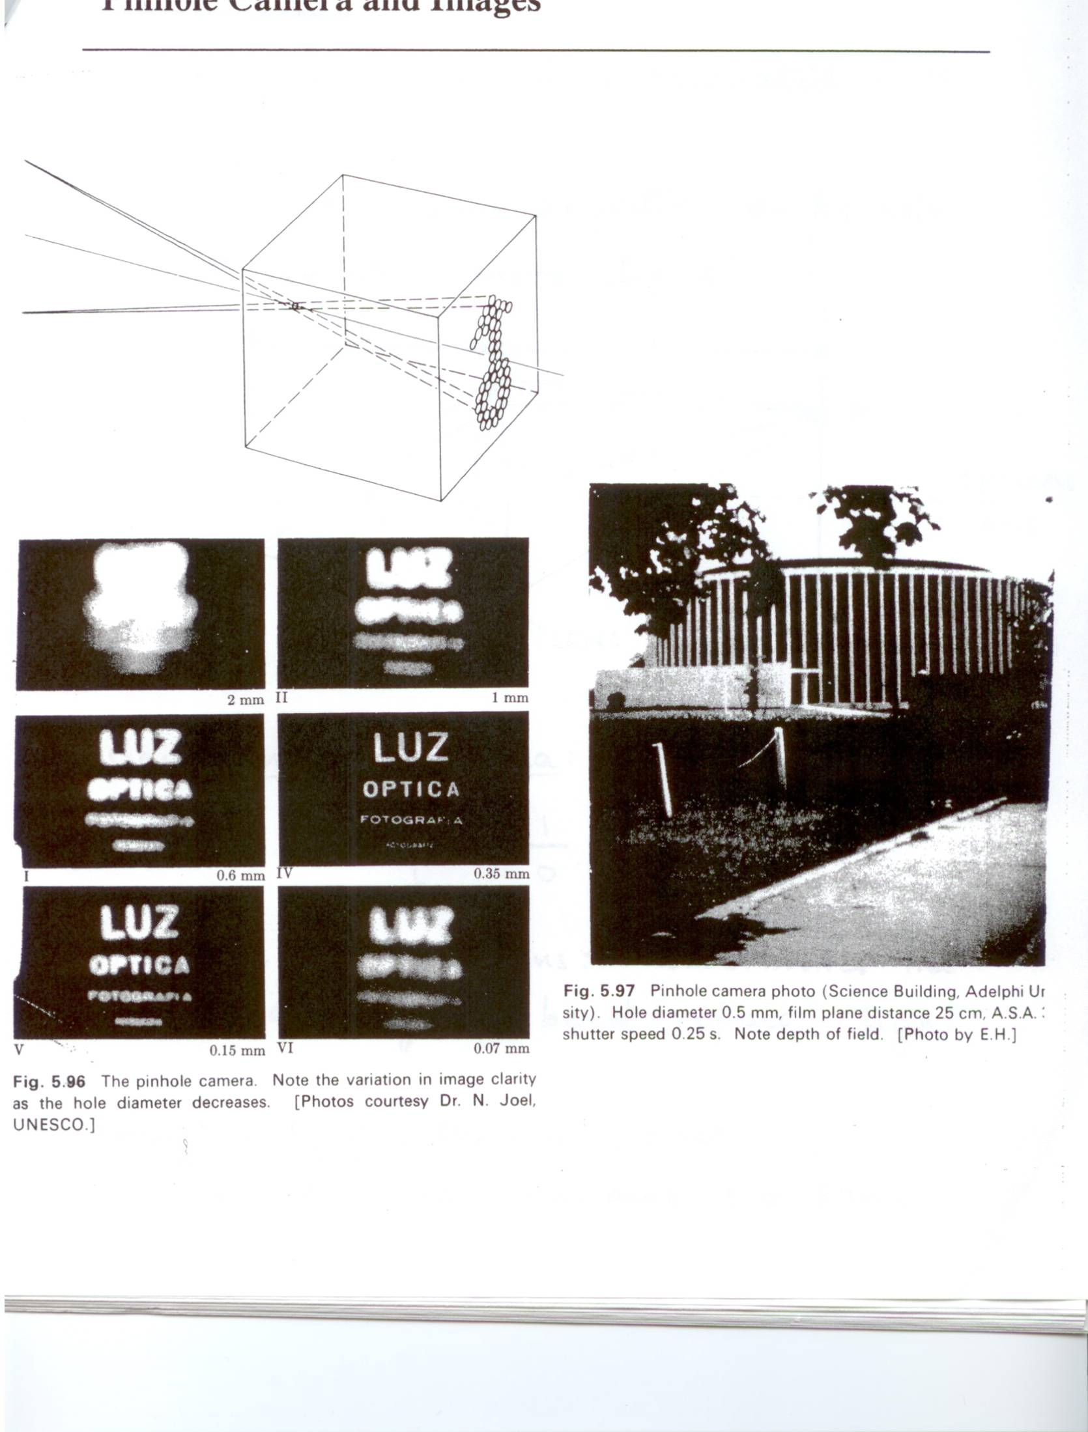
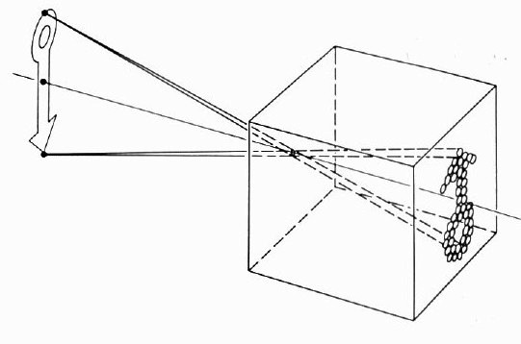
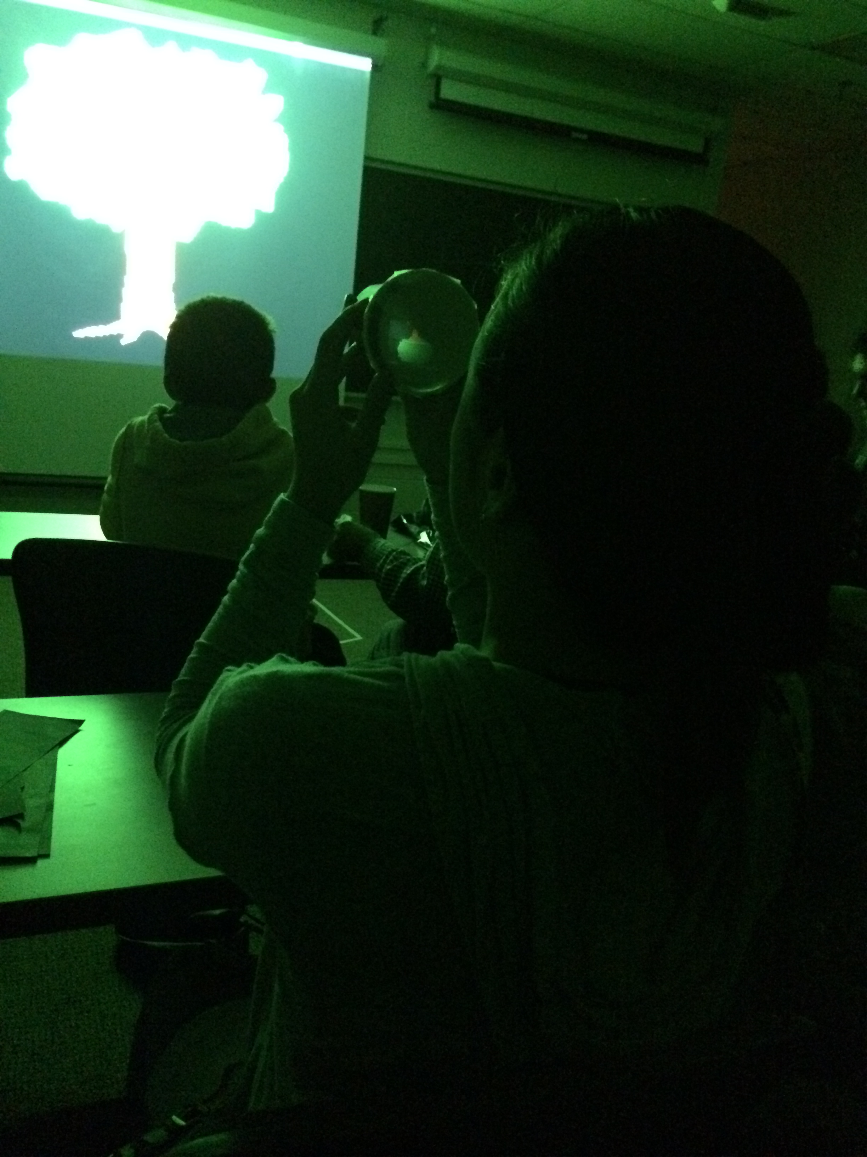
The pinhole camera
Camera obscura
First camera; known to Aristotle.
Aperture size impacts image.
Source: GD Hager and S Seitz slides.

Slide 17
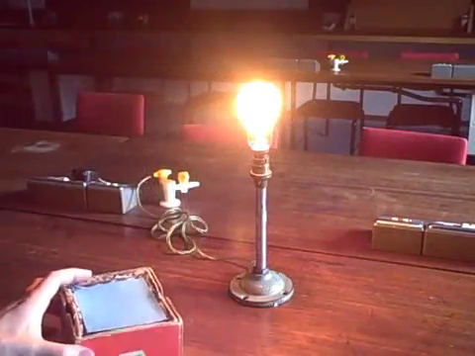
The pinhole camera
Source: https://youtube.com/watch?v=m5VVl0EhoJY

Slide 18
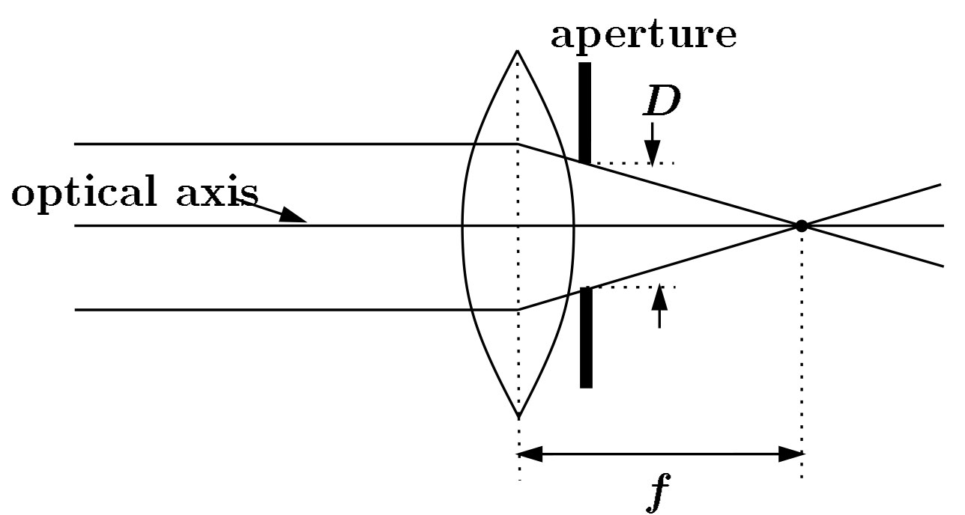
Adding a lens
A lens focuses the light onto the film/CCD.
Rays passing through the center are not deviated.
All parallel rays converge to one point on a plane located at the focal length f.
focal point
f
focal point
optical center
(Center Of Projection)
Source: GD Hager and S Seitz slides.

Slide 19
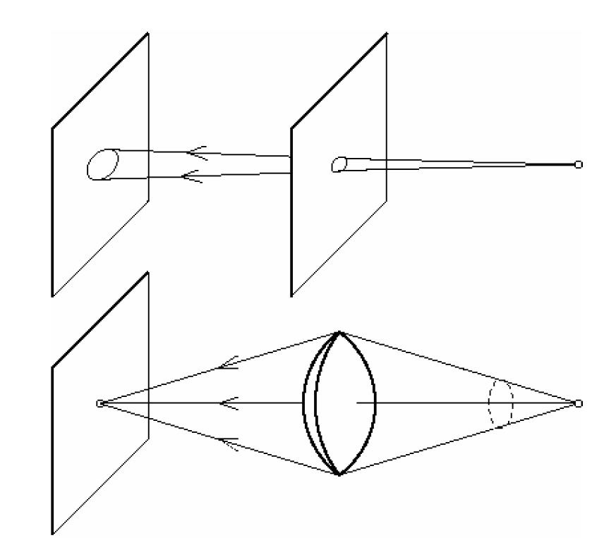
Pinhole vs. lens
Source: GD Hager and S Seitz slides.

Slide 20
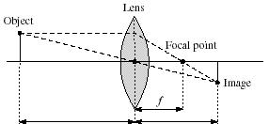
Thin lens equation
How to relate distance of object from optical center ( ) to the distance at which it will be in focus ( ), given focal length ?
Source: GD Hager and S Seitz slides.

Slide 21
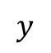
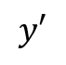
Thin lens equation
How to relate distance of object from optical center ( ) to the distance at which it will be in focus ( ), given focal length ?
Source: GD Hager and S Seitz slides.

Slide 22
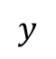
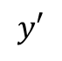
Thin lens equation
How to relate distance of object from optical center ( ) to the distance at which it will be in focus ( ), given focal length ?
Source: GD Hager and S Seitz slides.

Slide 23
Thin lens equation
Any object point satisfying this equation is in focus
Source: GD Hager and S Seitz slides.
Notes:
Note as u gets large relative to v, f tends toward v --- a typical simplying assumption

Slide 24
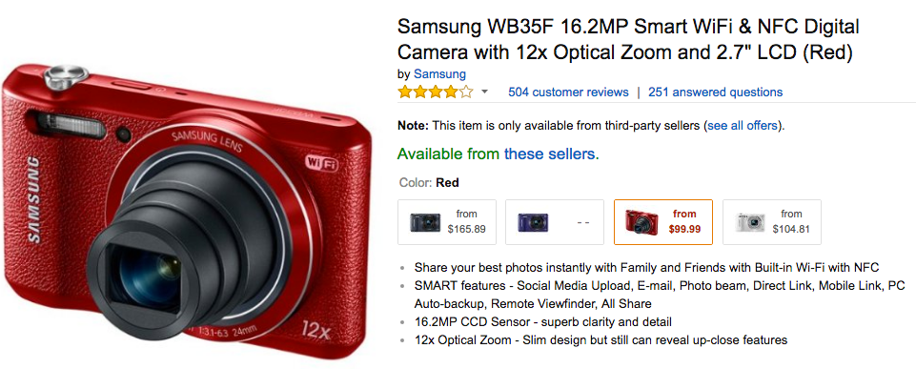
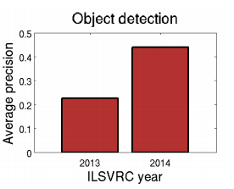
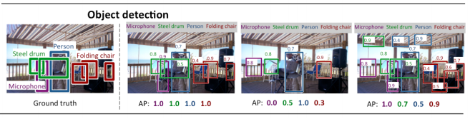
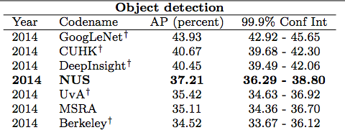
And we have our image…
Modern digital cameras capture upwards of 16 million pixels per image.
But modern systems still perform at a mediocre level for many tasks, such as object detection in the ImageNet large-scale visual recognition challenge.
And human performance is typically the gold standard (until recently).
Source: Russakovsky et al. “ImageNet Large Scale Visual Recognition Challenge.” IJCV 2015

Slide 25
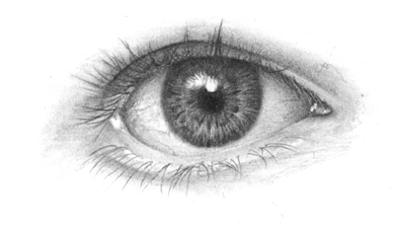
Human vision: a benchmark of sorts
Is a human eye just that much better than a CCD camera?

Slide 26
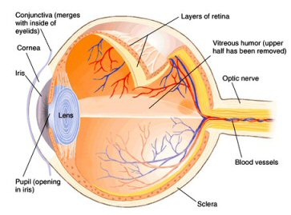
Structure of the eye
The iris is roughly equivalent to the aperture in a camera, the cornea and the lens are both lens-like objects, and the retina is where the image is recorded, similar to a CCD sensor or film.
Source: Dr. Ellen Keister, Physics 1230, U Colorado Fall 2012 slides and Seeing the Light by Falk, Brill and Stork (Wiley, 1986).

Slide 27
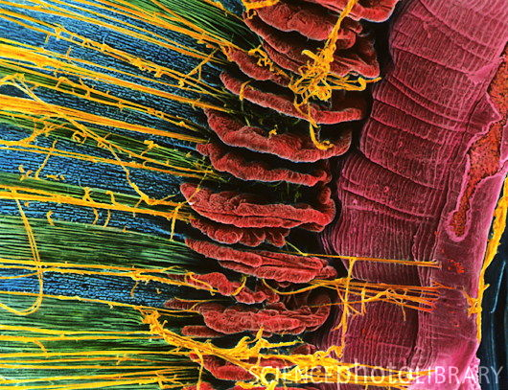
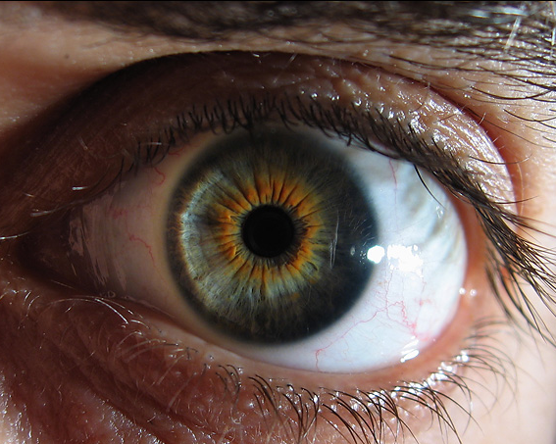
Structure of the eye: Iris
The iris is similar to the diaphragm/aperture in a camera
Your iris widens in dim light and narrows in bright light
The f-number of your eye varies from f/2 to f/8 (large opening) (small opening).
Compare this to the range of an average camera lens, which may have f-numbers from f/2.8 to f/22.
Source: Dr. Ellen Keister, Physics 1230, U Colorado Fall 2012 slides and Seeing the Light by Falk, Brill and Stork (Wiley, 1986).

Slide 28
Structure of the eye: iris
With a range of only f/2 – f/8, your iris can only reduce the light coming into your eye by a factor of 20.
The range of intensities that your eye can respond to is a factor of 10¹³
The main function of the iris is not to control the intensity of light coming into your eye
Main functions of iris
Reduce aberrations, sharpen image
Increase depth of field
Source: Dr. Ellen Keister, Physics 1230, U Colorado Fall 2012 slides and Seeing the Light by Falk, Brill and Stork (Wiley, 1986).

Slide 29
Structure of the eye: cornea and lens
Retina
Cornea
Eyelens
There are two lenses in your eye, the cornea and the eyelens.
The cornea, the front surface of the eye, does most of the focusing in your eye.
The eyelens (crystalline lens) provides adjustable fine-tuning of the focus.
Source: Dr. Ellen Keister, Physics 1230, U Colorado Fall 2012 slides and Seeing the Light by Falk, Brill and Stork (Wiley, 1986).

Slide 30
How a camera lens focuses
A typical camera is focused by changing the distance, ,from the lens to the image at the back on the CCD as the distance to the object, , changes.
Focal length (fixed)
Object distance
(varies)
Image distance
(changes to satisfy equation when changes)
Source: Dr. Ellen Keister, Physics 1230, U Colorado Fall 2012 slides and Seeing the Light by Falk, Brill and Stork (Wiley, 1986).

Slide 31
How a human eye focuses
The eyelens is a fixed distance, , from the retina at the back of the eyeball where the image is created.
Focal length (changes to satisfy the equation)
Object distance
(varies)
Image distance (fixed)
Source: Dr. Ellen Keister, Physics 1230, U Colorado Fall 2012 slides and Seeing the Light by Falk, Brill and Stork (Wiley, 1986).

Slide 32
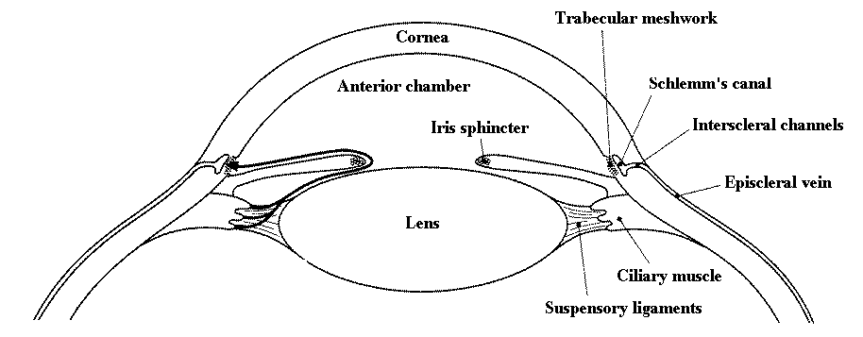
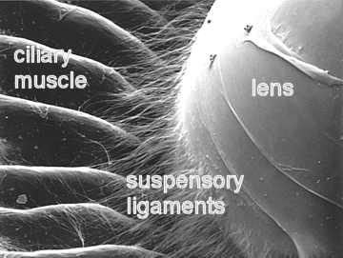
Eyelens: focusing and accommodation
The eyelens changes its focal length by changing its shape. Ligaments pull on the lens to change the amount of “bulge”.
Source: Dr. Ellen Keister, Physics 1230, U Colorado Fall 2012 slides and Seeing the Light by Falk, Brill and Stork (Wiley, 1986).

Slide 33
Eyelens: focusing and accommodation
Muscles contract, ligaments relax, more bulge, more bending power, shorter focal length
Ligaments
Eyelens
Muscles relax, ligaments contract, less bulge, less bending power, longer focal length
Source: Dr. Ellen Keister, Physics 1230, U Colorado Fall 2012 slides and Seeing the Light by Falk, Brill and Stork (Wiley, 1986).

Slide 34
Eyelens: focusing and accommodation
Your eyelens has a small depth of field
You can't see something close and far with both objects in focus at the same time.
Hold out your thumb about a foot away from your eye
Then, alternately focus on thumb and me (right above your thumb).
Note that you cannot see both me and your thumb sharply (in focus) at the same time
You focus on one or the other by changing the bulge of your eyelens.
Source: Dr. Ellen Keister, Physics 1230, U Colorado Fall 2012 slides and Seeing the Light by Falk, Brill and Stork (Wiley, 1986).

Slide 35


Eyelens: focusing and accommodation
thumb is out of focus
less bulgy, longer f
professor is in focus
thumb is in focus
more bulgy, shorter f
professor is out of focus
Source: Dr. Ellen Keister, Physics 1230, U Colorado Fall 2012 slides and Seeing the Light by Falk, Brill and Stork (Wiley, 1986).

Slide 36
Concept questions on focusing
You can't see me and your thumb clearly at the same time
because your pupil is too small
because your iris can't change fast enough
because your eye cannot accommodate
because your eye does not have enough depth of field
Source: Dr. Ellen Keister, Physics 1230, U Colorado Fall 2012 slides and Seeing the Light by Falk, Brill and Stork (Wiley, 1986).

Slide 37
Concept questions on focusing
When you see someone out-of-focus
There is no image anywhere
There is an in-focus image on your fovea
There is an in-focus image on your retina
There is an image in-focus either in front or in back of your retina
Source: Dr. Ellen Keister, Physics 1230, U Colorado Fall 2012 slides and Seeing the Light by Falk, Brill and Stork (Wiley, 1986).

Slide 38
Concept questions on focusing
In order to focus on close objects
your eyelens needs to bulge
your eyelens needs to flatten
your cornea needs to bulge
your cornea needs to flatten
the distance (x_{i}) between your eyelens and retina needs to change
Source: Dr. Ellen Keister, Physics 1230, U Colorado Fall 2012 slides and Seeing the Light by Falk, Brill and Stork (Wiley, 1986).

Slide 39
Structure of the eye: retina
The retina is the sensor or film of your eye.
Its layers do three things
Provide blood and nutrients (choroid)
Absorb light and convert to an electrical signal (photoreceptors)
Transfer the signal to the brain (nerve cells)
Light
Plexiform layer (nerve cells)
Rods and Cones (photoreceptors)
Choroid (blood vessels)
Source: Dr. Ellen Keister, Physics 1230, U Colorado Fall 2012 slides and Seeing the Light by Falk, Brill and Stork (Wiley, 1986).

Slide 40
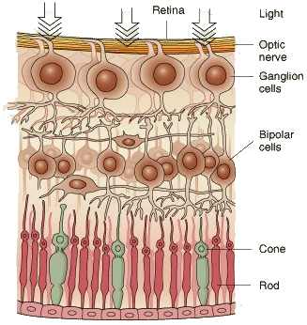
Structure of the retina
Light
← Nerve cells
← Photoreceptors
← Choroid
Source: Dr. Ellen Keister, Physics 1230, U Colorado Fall 2012 slides and Seeing the Light by Falk, Brill and Stork (Wiley, 1986).

Slide 41
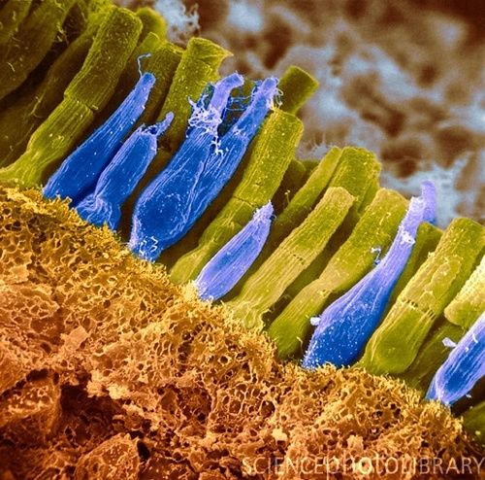
Photoreceptors: rods and cones
Light is detected and converted to an electrical signal by the photoreceptors in the retina. There are two main kinds of receptors, rods and cones.
This is a false color image, rods and cones are not actually different colors.
rod
cone
Source: Dr. Ellen Keister, Physics 1230, U Colorado Fall 2012 slides and Seeing the Light by Falk, Brill and Stork (Wiley, 1986).

Slide 42
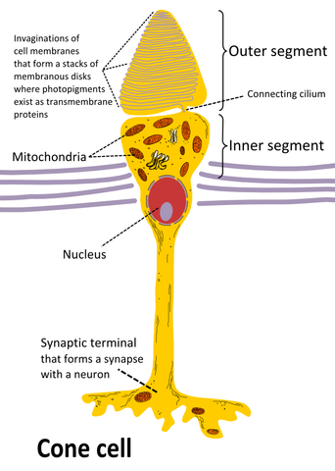
Photoreceptors: cones
Cones are responsible for our fine detailed and color vision
Cones are clustered near the center of your retina, called the fovea
There are 5 million cones in the average retina
Source: Dr. Ellen Keister, Physics 1230, U Colorado Fall 2012 slides and Seeing the Light by Falk, Brill and Stork (Wiley, 1986).

Slide 43
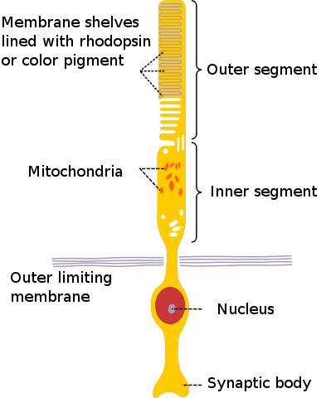
Photoreceptors: rods
Rods are responsible for low light and peripheral vision
They are present everywhere in the retina except the fovea
There are 125 million rods in the average retina
Source: Dr. Ellen Keister, Physics 1230, U Colorado Fall 2012 slides and Seeing the Light by Falk, Brill and Stork (Wiley, 1986).

Slide 44
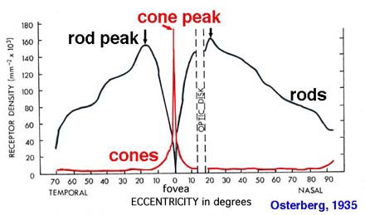
Rods and cones
Because of their different functions, rods and cones are present in varying densities in the retina. The blind spot is due to the connection of the optic nerve
Source: Dr. Ellen Keister, Physics 1230, U Colorado Fall 2012 slides and Seeing the Light by Falk, Brill and Stork (Wiley, 1986).

Slide 45
Human vision: our benchmark
Is a human eye just that much better than a CCD camera?
Definitely NOT!!!
Fewer pixels, less depth-of-field, etc.

Slide 46
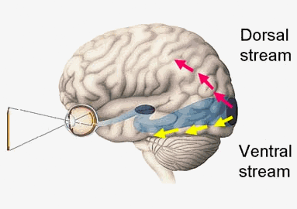
Human vision: our benchmark
Is a human eye just that much better than a CCD camera?
Then how do humans see so well?
Notes:
Dorsal is where and ventral is what

Slide 47
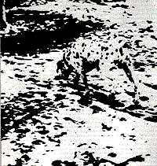
Human vision: our benchmark
Source: G.D. Hager Slides.

Slide 48
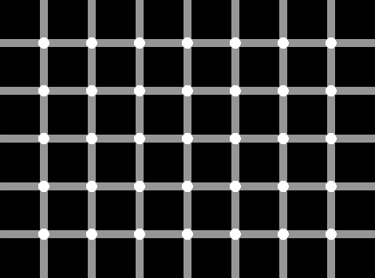
Illusions: what do they tell us?
Source: G.D. Hager Slides.

Slide 49

Illusions: what do they tell us?
Source: G.D. Hager Slides.

Slide 50

Why is computer vision hard?
Source: G.D. Hager Slides.

Slide 51
Why is computer vision hard?
Source: G.D. Hager Slides.

Slide 52
Why is computer vision hard?
“Context” counts for as much as appearance.
Huge amounts of prior knowledge (learned and innate).
AI complete (hard to solve a cleanly defined “simple” problem without invoking unrealistic assumptions).
Lack of a clear metric for success (indeed, we are often completely wrong as you’ve seen).
The diversity of the natural world.
Source: G.D. Hager Slides.

Slide 53
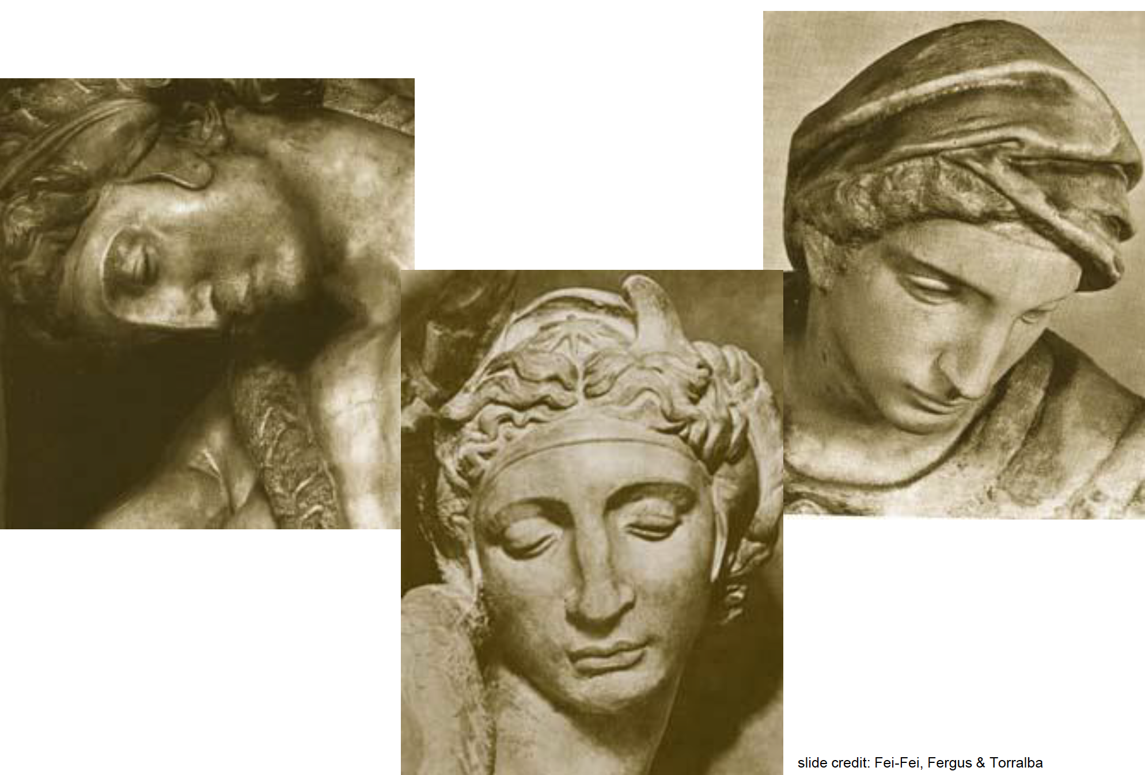
Challenges: viewpoint variation

Slide 54
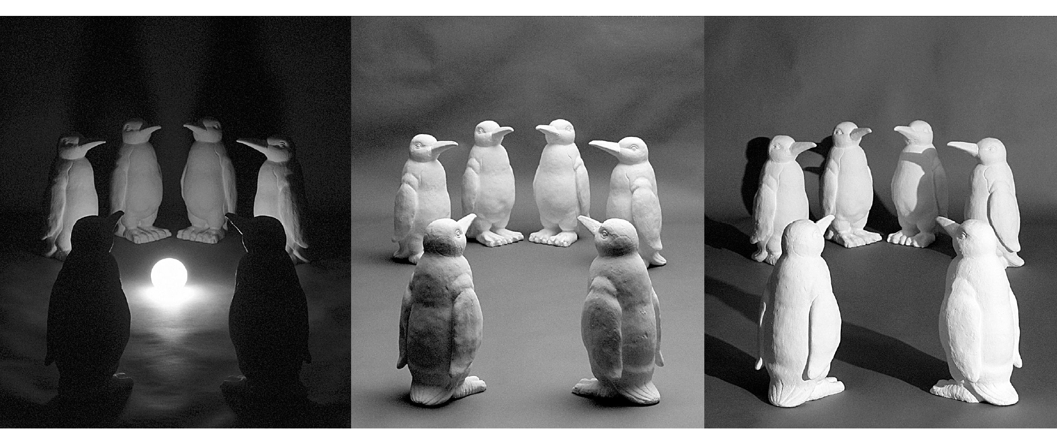
Challenges: illumination variation
Source: Saverese slides; Koenderink image.

Slide 55
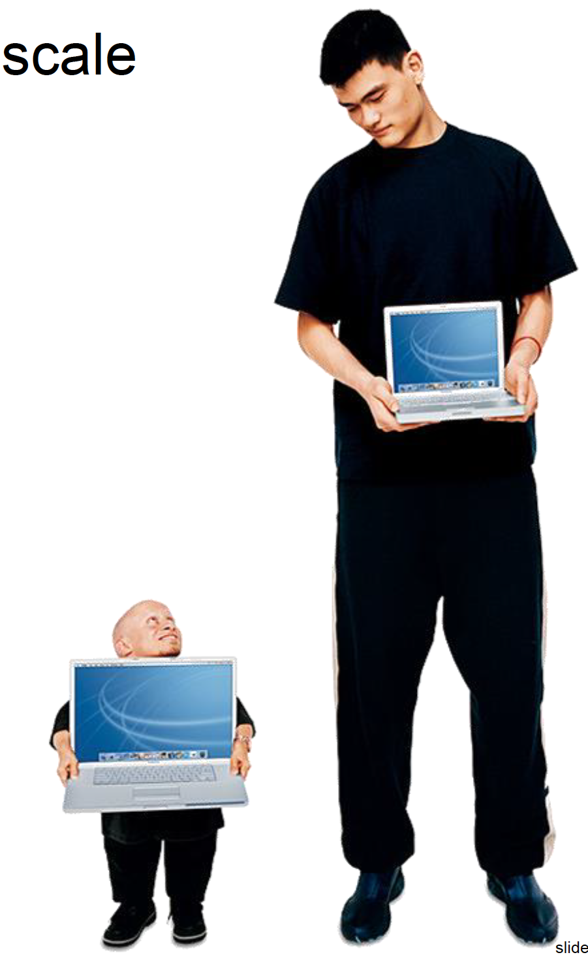
Challenges: scale variation
Source: Saverese, Fei-Fei, Fergus, and Torralba.

Slide 56

Challenges: deformation and structure variation
Source: Saverese slides.

Slide 57

Challenges: occlusion
Source: Magrit 1957; Saverese, Fei-Fei, Fergus, and Torralba.

Slide 58

Challenges: background clutter or context variation
Source: Kilmeny Niland 1995; Saverese slides.

Slide 59

Challenges: intra-class variation
Source: Saverese, Fei-Fei, Fergus, and Torralba slides.

Slide 60

Challenges: class variation
Source: Saverese slides.

Slide 61

Challenges: ambiguity
Source: Rob Fergus and Antonio Torralba

Slide 62

Challenges: ambiguity
Source: Rob Fergus and Antonio Torralba

Slide 63


Challenges: ambiguity
slide credit: Fei-Fei, Fergus & Torralba

Slide 64


Challenges: ambiguity
Many different 3D scenes could have given rise to a particular 2D picture
[Sinha and Adelson 1993]
Source: S. Lazebnik

Slide 65



Scenes are unique
Slide credit: A. Torralba
Notes:
Scene and object recognition at human performance is very hard because we are able to deal with so many different kinds of scenes…
Scenes are so unique.

Slide 66









But not all scenes are so original
Slide credit: A. Torralba
Notes:
But most scenes are not really like that. Most of the time, scenes are boring places in which nothing really surprising happens. For instance, this street… there is nothing really special about it. In fact, I can easily find thousands of other street pictures that look just like this. Of course, these scenes are different in the details, just as two faces are different, but at a coarser level they are form by similar objects arranged in a similar spatial configuration.

Slide 67









But not all scenes are so original
Slide credit: A. Torralba
Notes:
But most scenes are not really like that. Most of the time, scenes are boring places in which nothing really surprising happens. For instance, this street… there is nothing really special about it. In fact, I can easily find thousands of other street pictures that look just like this. Of course, these scenes are different in the details, just as two faces are different, but at a coarser level they are form by similar objects arranged in a similar spatial configuration.

Slide 68
Computer Vision: A Search for Invariance
One major theme of the semester (and computer vision) is the search for invariance.
Invariant/Invariance: a function, quantity, or property that remains unchanged when a specified transformation is applied.
Note usage, e.g.,
Algorithm X is scale invariant.
Algorithm X demonstrates scale invariance.
Examples we will work through
Shift, scale, rotation, affine, photometric, projective, deformation, structure, class, category, rate

Slide 69


Major Themes
Computer Vision as a search for visual invariants.
Computer Vision as optimization.
Nearly all (well-done) examples of computer vision methods/systems can be posed a minimization of some objective.
Representation of visual content is an important issue.
Images as functions
Continuous vs. discrete in domain and range
Images as points (or coefficients)
Standard bases: Cartesian basis, Fourier basis
Learned bases.
Images as graphs
Pixels induce nodes.
Connectivity?
Module 1

Slide 70
Core Abstracted Problems in Computer Vision
Module 2
Reduction
Transforming visual content into an alternative representation, often with the loss of data, but with the retention of important characteristics (think invariance).
E.g., segmentation, feature extraction, local edge detection
Matching
Finding local correspondences between comparable representations of visual content, with the potential of incorporating global regularizing constraints.
E.g., stereo correspondence, image retrieval
Fitting
Estimating the parameters of a model from a set of representations of visual content and potentially correspondences.
E.g., image registration, 3D reconstruction
Notes:
Note that I probably need to revise the mathematical equations on this slide.

Slide 71







Computer Vision Problems and Applications
Image denoising
Image search / retrieval
Reconstruction and Structure from Motion
Recognition of objects, actions, scenes
Tracking of objects and articulation
Segmentation
Detection
Optical flow

Slide 72
Course Information
Syllabus
Contains all necessary information for course structure and grading.
35% Homework
15% Project
20% Quizzes
20% Exam
10% Participation (Read/Annotate)
Canvas
https://umich.instructure.com/courses/173857
ALL discussions on piazza.
Nota Bene: http://nb.engin.umich.edu
Used for reading/annotating.
Typical week
Tuesday 70 minutes lecture and 10 minutes modern vision demo
Thursday 20 min quiz (including discussion), 55 minutes lecture/question answering/attention to NB discussions and 5 min 10K foot where we are and where we are going.
All class periods begin with an open forum for questions.
Note we have two GSIs (Siyuan Chen and Byungsu Kyle Min) who will host office hours and an optional discussion session during which time you can discuss questions and homeworks.

Slide 73
Coming up in Week 2
Readings will be posted by Thursday class.
Mathematical preliminaries
Linear least squares
Lagrange Multipliers
Matrices and Linear Algebra
Eigendecomposition and SVD
Homework 0a: ensure familiarity with Matlab
http://ctms.engin.umich.edu/CTMS/index.php?aux=Basics_Matlab
http://www.math.ucsd.edu/~bdriver/21d-s99/matlab-primer.html
Homework 0b: spend 30 minutes browsing each
Price Vision Bib: http://www.visionbib.com/bibliography/contents.html
CVPapers: http://cvpapers.com/
Homework 1 will be released next week.
Of course, these are review (in total, this is at least 1 course of background.) But, we need to calibrate across backgrounds.
These are many of the core tools we will see time and time again in this course.
Or NumPY
for the risk-takers among us

